Slide 1
Cancer Data Analysis: SVM and Naïve Bayes Model
Srilasya Garigipaty
100822953

Slide 2
Analysis Methods Description: SVM Algorithm
SVM(“Support Vector Machines”) segregates a dataset in the best possible way. SVM constructs a hyperplane in a multidimensional space and separates data into different classes.
SVM generates the optimal hyperplane in an iterative manner, which is used to minimize an error.
The core idea of SVM is to find a maximum marginal hyperplane (MMH) that best divides the dataset into classes. In order to achieve MMH the margin between classes should have the same distance.
Support vectors are the data points, which are closest to the hyperplane. These points will define the separating line better by calculating margins. These points are more relevant to the construction of the classifier.
A hyperplane is a decision plane which separates between a set of objects having different class memberships.
A margin is a gap between the two lines on the closest class points. This is calculated as the perpendicular distance from the line to support vectors or closest points. If the margin is larger in between the classes, then it is considered a good margin, a smaller margin is a bad margin.

Slide 3

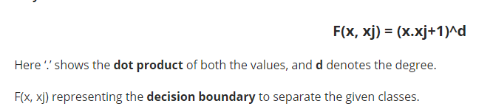
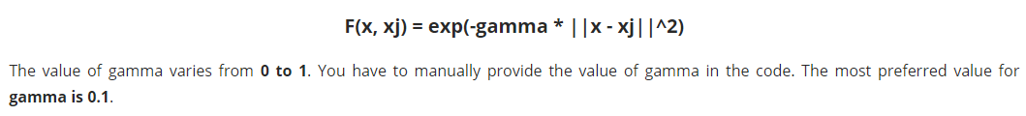
Most Popular SVM Kernels
The SVM algorithm is implemented in practice using a kernel. A kernel transforms an input data space into the required form.
Linear Kernel A linear kernel can be used as normal dot product any two given observations. The product between two vectors is the sum of the multiplication of each pair of input values.
Polynomial Kernel A polynomial kernel is a more generalized form of the linear kernel. The polynomial kernel can distinguish curved or nonlinear input space.
Radial Basis Function Kernel The Radial basis function kernel is a popular kernel function commonly used in support vector machine classification. RBF can map an input space in infinite dimensional space.

Slide 4
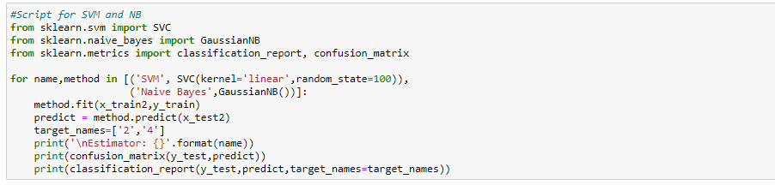
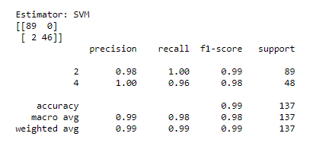
SVM Algorithm Parameters used for Cancer Data
In the Support Vector Machine Algorithm the kernel used was ‘linear’ with a random state of 100. This Support Vector
Machine Algorithm was modeled on the training cancer data, and predicted on the test cancer data. After the model was
predicted on the test data, a classification report and confusion matrix were printed to evaluate the model as shown :

Slide 5
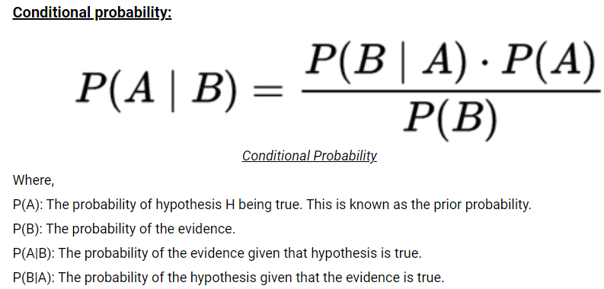
Analysis Methods Description: Naïve Bayes Algorithm
It is a classification technique based on Bayes’ Theorem, with an assumption of independence among predictors.
Bayes Theorem is a theorem that works on conditional probability. Conditional Probability is the probability that something will happen, given that something else has already occurred. The conditional probability can give us the probability of an event using its prior knowledge.
The class having maximum probability is selected as the most suitable class.
The Naïve Bayes algorithm is used in various real-life scenarios such as text Classification, multi-class prediction, recommendation systems, and much more.

Slide 6
Types of Naïve Bayes Algorithms
1. Gaussian Naïve Bayes: When characteristic values are continuous in nature then an assumption is made that the values linked with each class are dispersed according to Gaussian that is Normal Distribution.
2. Multinomial Naïve Bayes: Multinomial Naive Bayes is favored to use on data that is multinomial distributed. It is widely used in text classification in NLP. Each event in text classification constitutes the presence of a word in a document.
3. Bernoulli Naïve Bayes: When data is dispensed according to the multivariate Bernoulli distributions then Bernoulli Naive Bayes is used. That means there exist multiple features but each one is assumed to contain a binary value. So, it requires features to be binary-valued.

Slide 7
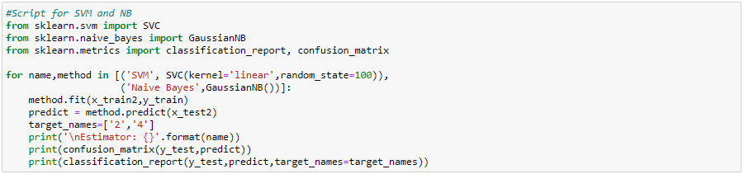
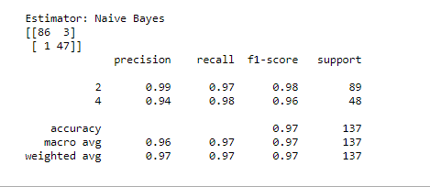
Naïve Bayes Algorithm Parameters used for Cancer Data
In the Naïve Bayes Machine Algorithm the type used was ‘Gaussian’ with a random state of 100. This Naïve Bayes
Machine Algorithm was modeled on the training cancer data, and predicted on the test cancer data. After the model was
predicted on the test data, a classification report and confusion matrix were printed to evaluate the model as shown :

Slide 8
Evaluation Table For both Models
Evaluation Metric | SVM Algorithm | Naïve Bayes Algorithm
Precision | 99% | 96%
Recall | 98% | 97%
F1 Score | 98% | 97%
Accuracy | 99% | 97%
Confusion Matrix | 2 False Negative, 0 False Positive | 1 False Negative, 3 False Positive

Slide 9
SVM Model Insights from Findings
There are 2 classes categorized as “2” for a benign cancer and “4” for a “malignant” cancer. The SVM model took a train size of 0.8 and a test size of 0.2 to run the model on.
The final algorithm of the SVM model showed the following results:
Accuracy: Accuracy is the ratio of correct predictions to total predictions made. In SVM model, accuracy was 99%.
Precision: Precision is how accurate your model is . In SVM model, 98% of Class 2 benign cancers were correctly predicted, and 100% of Class 4 malignant cancers were correctly predicted. Overall precision is 99%.
Recall: Recall is the ratio of correctly predicted positive observations to all observations in actual class. In SVM model, Class 2 benign cancer can be correctly predicted 100% of the time. Class 4 malignant cancers can be correctly predicted 96% of the time. Overall recall is 98%
F1 score: F1 Score is the weighted average of Precision and Recall. In SVM model case, 98% is the F1 score.
The confusion matrix shows that SVM Algorithm misclassified two cancer tumors out of 137 tumor test data the SVM Algorithm was predicted on.

Slide 10
Naïve Bayes Insights from Findings
There are 2 classes categorized as “2” for a benign cancer and “4” for a “malignant” cancer. The Naïve Bayes model took a train size of 0.8 and a test size of 0.2 to run the model on.
The final algorithm of the Naïve Bayes model showed the following results:
Accuracy: Accuracy is the ratio of correct predictions to total predictions made. In Naïve Bayes model, accuracy was 97%.
Precision: Precision is how accurate your model is . In Naïve Bayes model, 99% of Class 2 benign cancers were correctly predicted, and 94% of Class 4 malignant cancers were correctly predicted. Overall precision is 96%.
Recall: Recall is the ratio of correctly predicted positive observations to all observations in actual class. In Naïve Bayes model, Class 2 benign cancer can be correctly predicted 97% of the time. Class 4 malignant cancers can be correctly predicted 98% of the time. Overall recall is 97%
F1 score: F1 Score is the weighted average of Precision and Recall. In Naïve Bayes model case, 97% is the F1 score.
The confusion matrix shows that Naïve Bayes Algorithm misclassified four cancer tumors out of 137 tumor test data the Naïve Bayes Algorithm was predicted on.

Slide 11
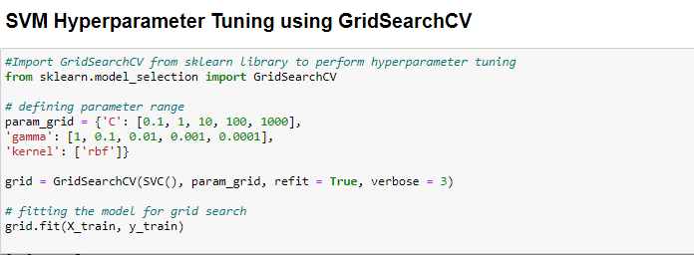
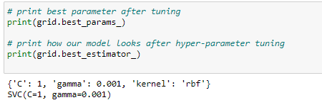
Ways to Improve SVM Algorithm: SVM Hyperparameter tuning using GridSearchCV
A Machine Learning model is defined as a mathematical model with several parameters that need to be learned from the data. However, there are some parameters, known as Hyperparameters that cannot be learned.
Hyperparameters are important because they work by improving performance of the model such as its complexity or its learning rate. Models can have many hyper-parameters and finding the best combination of parameters can be treated as a search problem.
GridSearchCV tries various combinations of hyperparameters to train the model and predict on test data to improve performance of model for accuracy and prediction results.
Changed kernel type to “rbf” –radial basis function kernel to see if there was any improvement or changes compared to kernel “linear”.

Slide 12
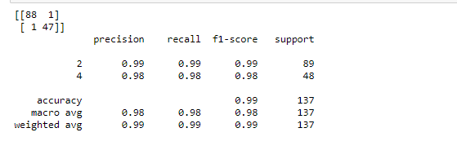
Results SVM Algorithm: SVM Hyperparameter tuning using GridSearchCV
The final algorithm of the GridSearchCV SVM model showed the following results:
Accuracy: Accuracy is the ratio of correct predictions to total predictions made. In SVM tuned model, accuracy was 99%.
Precision: Precision is how accurate your model is . In SVM tuned model, 99% of Class 2 benign cancers were correctly predicted, and 98% of Class 4 malignant cancers were correctly predicted. Overall precision is 98%.
Recall: Recall is the ratio of correctly predicted positive observations to all observations in actual class. In SVM tuned model, Class 2 benign cancer can be correctly predicted 99% of the time. Class 4 malignant cancers can be correctly predicted 98% of the time. Overall recall is 98%
F1 score: F1 Score is the weighted average of Precision and Recall. In SVM tuned model case, 98% is the F1 score.
The confusion matrix shows that SVM tuned Algorithm misclassified two cancer tumors out of 137 tumor test data the SVM tuned Algorithm was predicted on. 1 False Negative, 1 False Positive.

Slide 13
Recommendation and Justification for Mr. John to use for Analysis
Mr. John Should use the SVM Model for his Analysis. This is a better model to use compared to the Naïve Bayes in this situation because it was seen from insights that the precision, recall, accuracy, f1 score were all higher than the Naïve Bayes Model and there were fewer number of false predictions.
The SVM model is also a better option to use for analysis because the Naïve Bayes Model treats all features as independent of one another, but when a correlation function was done, some of the features in dataset were found to have some correlation between one another. Thus, the assumption that all features are independent is less likely a correct assumption. This also means some features have a higher bias.
Though Naïve Bayes trains the data quicker than an SVM Algorithm and requires only a small amount of training data to create model for test data , this can lead to inaccuracies.
In classification tasks it is better to have a big data set in order to make reliable estimations of the probability of each class. You can use Naïve Bayes classification algorithm with a small data set, but precision and recall will be low.
Naïve Bayes does not have as many ways to hyper tune or improve the algorithm. With small datasets this is satisfactory, but it will be a hard model to work with when there are a lot of complex features compared to SVM model where more options are available for improvement.

Slide 14
References
DATA 1200 WEEK 7 SVMNBE NOTES
https://www.analyticsvidhya.com/blog/2017/09/understaing-support-vector-machine-example-code/
https://www.geeksforgeeks.org/svm-hyperparameter-tuning-using-gridsearchcv-ml/
https://towardsdatascience.com/all-about-naive-bayes-8e13cef044cf

